Slide 1

Time SERIES FORECASTING: Predict Live Stock Prices Using Yahoo Finance

Slide 2
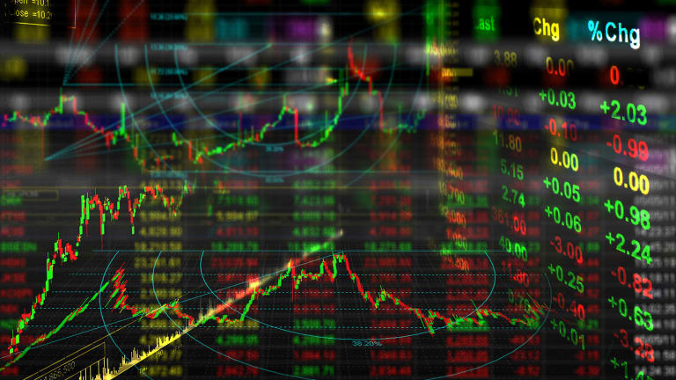
Time Series ?
Time series forecasting is the process of analyzing time series data using statistics and modeling to make predictions and inform strategic decision-making.

Slide 3
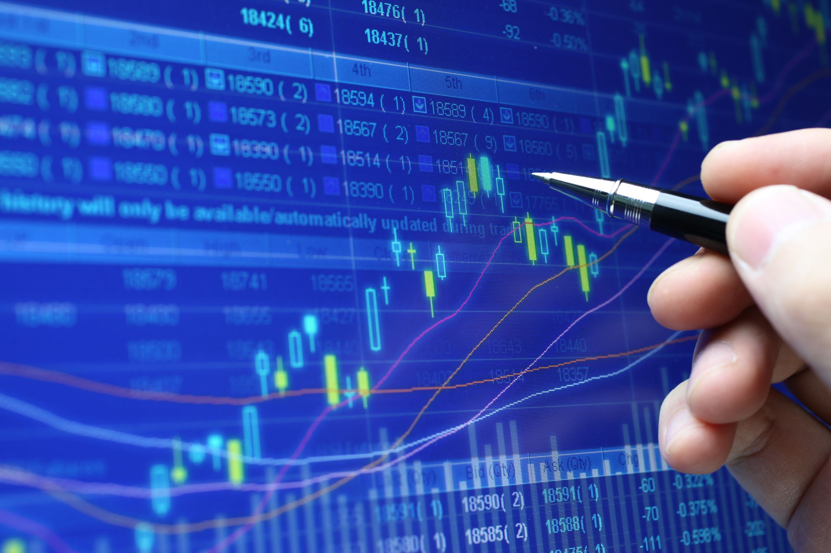
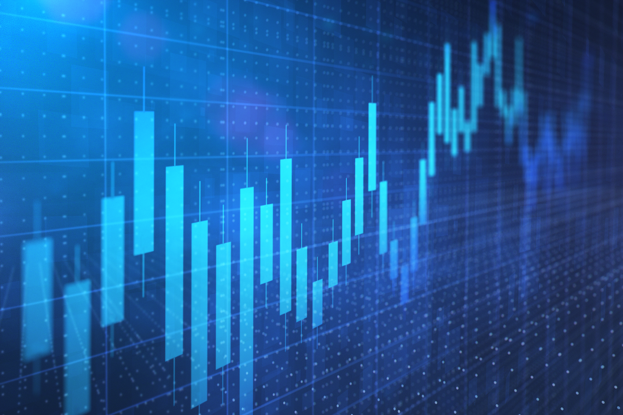
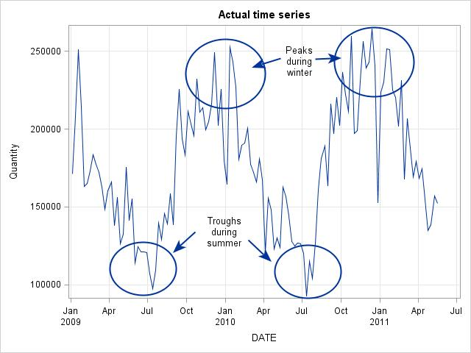
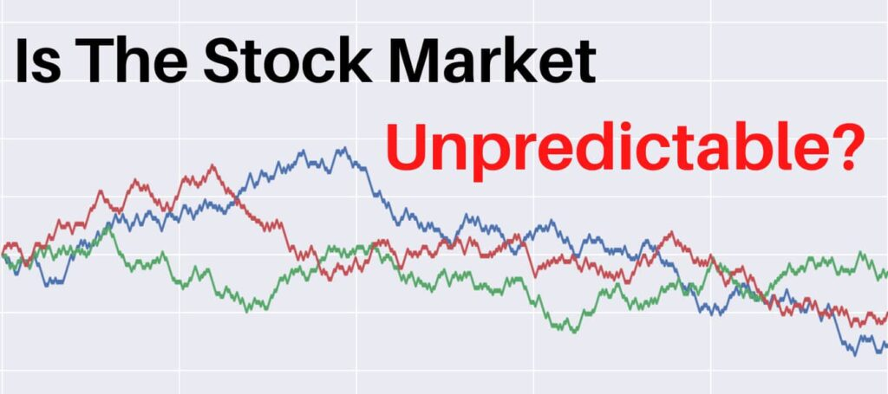
Components of Time Series
Trend
The trend shows the general tendency of the data to increase or decrease during a long period of time
Seasonal Variations
These are the rhythmic forces which operate in a regular and periodic manner over a span of less than a year.
Cyclic Variations
The variations in a time series which operate themselves over a span of more than one year are the cyclic variations.
Random /Irregular Movements
They are not regular variations and are purely random or irregular.

Slide 4
Section 1: Introduction and problem specification
Industry: The project is about predicting the prices of the live stocks using yahoo finance. The industry we are targeting is Finance and it is related to every company in the retail, banking, health-care, and logistics & transportation sectors.
WHY ?
A company's stock price reflects investor perception of its ability to earn and grow its profits in the future.
Predicting stock prices is very important for finance practitioners to best allocate their assets and to academics to build better and more accurate asset pricing models.
Predicting stock returns gives crucial implications about market efficiency.

Slide 5

Problem specification:
In this project, we are predicting whether the future price of a stock goes upward or downward (depicted as “Target”-(1/0)) based on past values of the data.
There are many websites predicting the stock prices. But they are predicting the stock prices of tomorrow based on today data. In my Knowledge, this is the first project where we are predicting the price of the stock change from minute to minute.
Stock prices change from milli second to milli second based on situations happening around the world. That’s why it is important to develop a model that can help to predict the stock price from second to second.
This is famous for the Intraday Traders.

Slide 6
Data Characteristics:
Independent Variables: DateTime, Stock Symbol, Company, Open, High, Close, Low, AdjClose, Volume.
Dependent Variable: Target
Model Type: Binary Classification

Slide 7
How data relate to the problem being solved:
When we see the data characteristics, we can observe that the attributes are Datetime which is a time series component has instances starting from 9:30 am to 4:00 pm, is the time period in which stock market functions.
Open, Close, High and Low are stock prices of each company with respect to time.
AdjClose is the adjusted closing price factors in anything that might affect the stock price after the market closes.

Slide 8
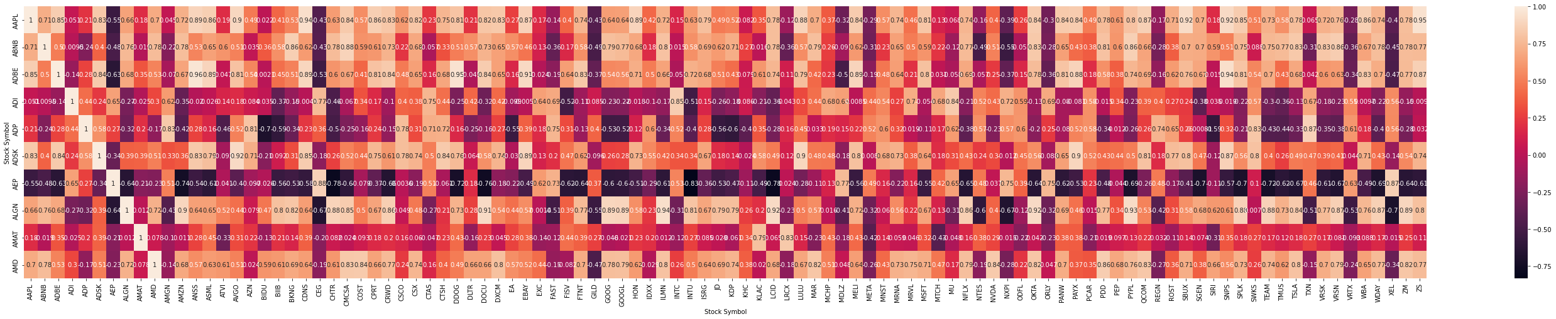
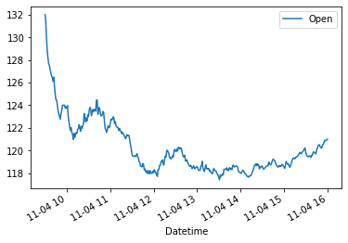


Visualizations:

Slide 9
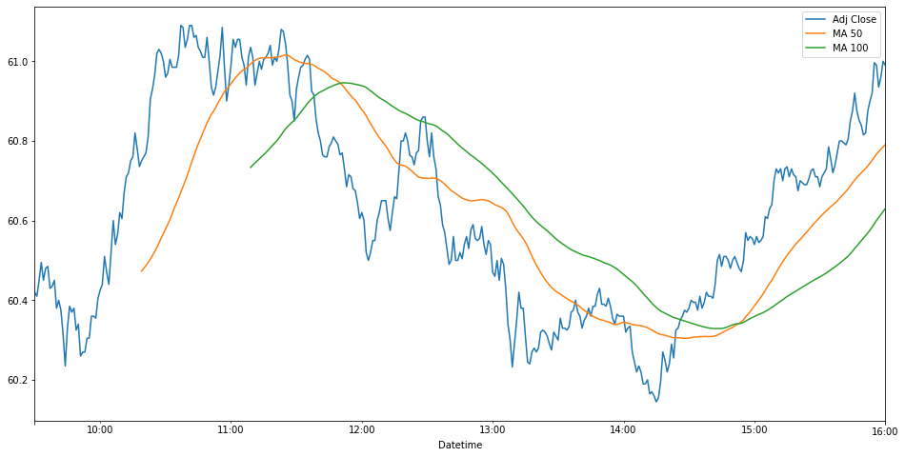
Moving Averages:
A Moving average is a tool used by the technical analysts to track the price movements of a stock. It plots average prices over a defined period of time, with the moving average typically overlaid onto a candlestick or bar chart or line plot.

Slide 10
DM Models:
This is a binary classification supervised problem; hence we used classification algorithms like Random forest, logistic regression algorithms, support vector machines.
Model | Accuracy | Interpretability
Random forest | 60% | Medium
Logistic Regression | 77% | Low
Support Vector Machines | 61% | High

Slide 11
Evaluation Metrics:
class | Actual yes | Actual no
Predicted yes | 5656 | 468
Predicted no | 2182 | 3308

Slide 12
Conclusion:
Results:
From the accuracy and confusion matrix, Logistic regression is the best classifier when compared to the random forest and Support vectors with 77% accuracy.
The model is telling that 77% of times the price of the stock goes up in the next second out of 100 times. Though it is not an accurate model, I would consider this as the better model.

Slide 13
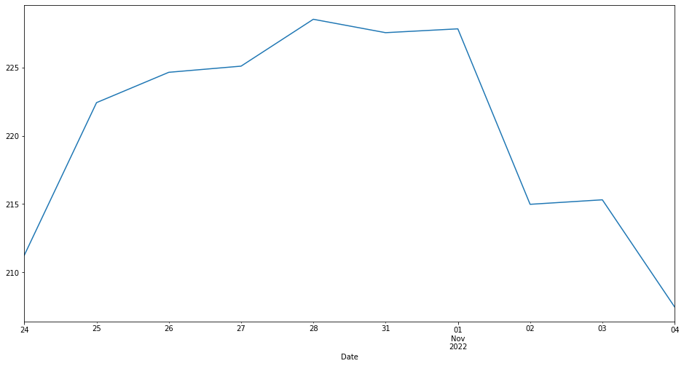
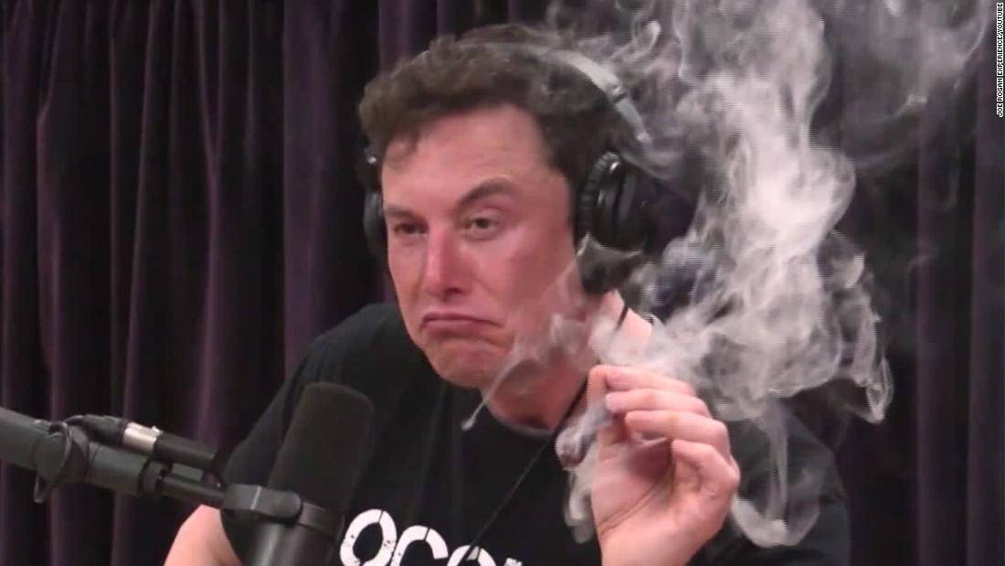



Finding:
For our analysis, we have taken the recent news that musk had officially took over the Twitter. We have recorded the change is price of the ‘TESLA’ when Elon musk bought the twitter on the 27- oct- 2022.

Slide 14
Current Problem:
Since there are random fluctuations in the stock price trend, it is hard to predict the exact value.
Solution:
We have written a custom logic that used moving averages to predict the trend of the data. With the help of moving average, we used that data to create a model. If all the variables are held constant, then my model will be able to predict the future price of the data base don past and current data.
CEO Solution:
Using my model, CEO can predict the future price of the stock. This way investors can decide whether to invest in company or not.

Slide 15
Percentage of credit for each member in the team:
Name | Role | % work completed
1. Sai Vinay | Team leader + Developer + Analyst | 100%
2. Abhinav | Developer + Analyst | 100%
3. Akshay | Developer + Analyst | 100%
4. Praharsha | Analyst + Clerical | 100%
5. Shreya | Analyst + Clerical | 100%
6. Shivani | Analyst + Clerical | 100%

Slide 16
Thank you

